Slide 1
ASTRON: LUNAR LINES OF POSITION
This presentation is solely to illustrate Astron’s new feature to plot Lunar Lines of Position. This differs in some detail from the procedure to use Astron for a conventional Lunar sight.
Assuming accurate time is known, a sextant measurement of the arc between a limb of the Moon and a suitable other body can yield a Lunar Line of Position (LLOP).
No horizon is needed, just the arc measurement. An LLOP is far less accurate than a traditional line of position, but possibly useful after (say) many days of cloud and a clearing during night time.
A Lunar Line of Position is a locus of points on the Earth where the Sextant Arc between the Moon and the selected body at the entered instant is identical to the sextant arc value (LDs) that you have entered for this sight.
Astron can plot several LLOPs and they can be advanced, retired and freely mixed with conventional lines of position.
s

Slide 2
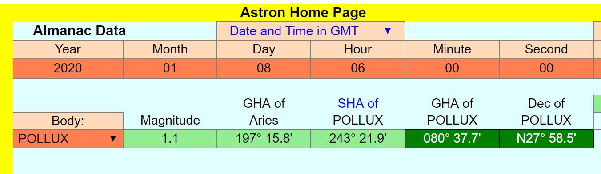
HOME PAGE INPUTS : 1 & 2
1. Using GMT mode, enter date and exact time of sight. (2020 : 01 : 08 : 06 : 00 : 00)
2. Select the body (POLLUX) whose arc distance from the Moon you have measured.
s

Slide 3
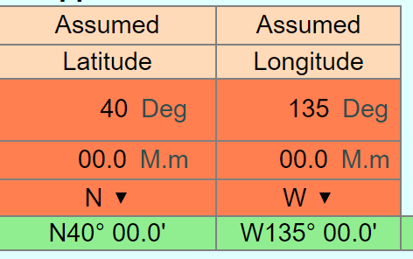
HOME PAGE INPUTS : 3
1.Insert your DR position.
Astron will only plot the LLOP within an area +/- 10 degrees of latitude/longitude of this position.
s

Slide 4
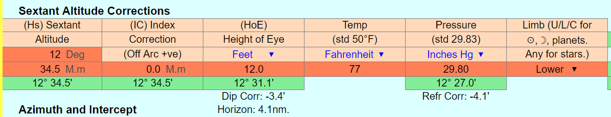


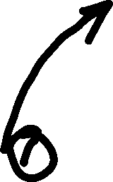
HOME PAGE INPUTS : 4
1. Insert your Index Correction. This is used for all LLOP calculations.
2. Insert Temperature and Pressure. These are assumed to be constant over the whole +/- 10 degree plotted area!
3. Sextant Altitude, HoE and limb corrections to body altitude are not used by the LLOP process.
s

Slide 5

HOME PAGE INPUTS : 5
That is the Home Page inputs completed.
There is much other information on the Home Page, but not relevant to plotting a Lunar Line of Position.
Remember that this presentation only concerns plotting a LLOP. If you are wanting to deduce GMT from a lunar sight, see the User Notes.
So now visit the Lunar Sight page.
s

Slide 6
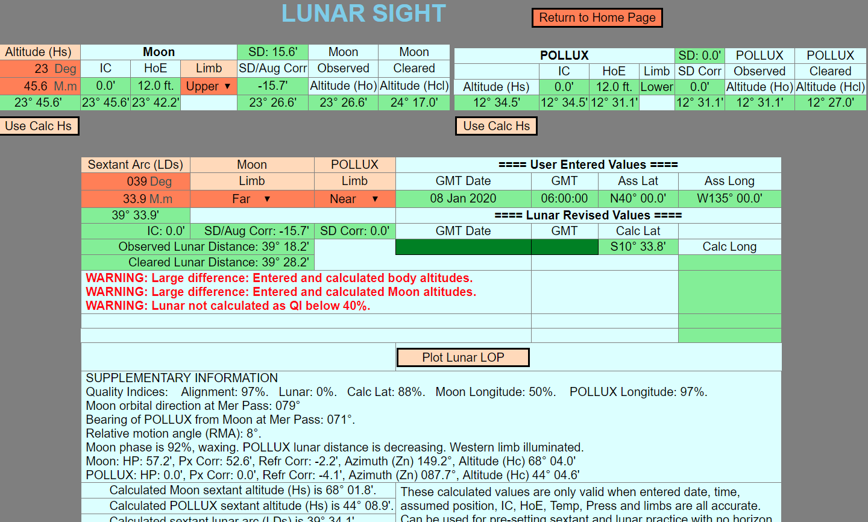



LUNAR PAGE INPUTS : 1
1. Ignore any warnings! They apply to ‘conventional’ Lunar sights.
2. Insert your measured arc in the Sextant Arc (LDs) cells, in this case, 39 33.9’, and appropriate limbs.
3. Press the “Plot Lunar LOP” button.
s

Slide 7
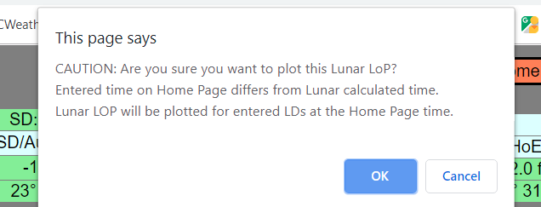
LUNAR PAGE INPUTS : 2
This pop-up caution will appear because this Astron page is designed to calculate GMT from a lunar sight and two associated altitude sights.
In the present example, all you want to do is plot the LLOP for the entered Sextant Arc (LDs) , in this case, 39 33.9’, and appropriate limbs.
So just press OK.
s

Slide 8
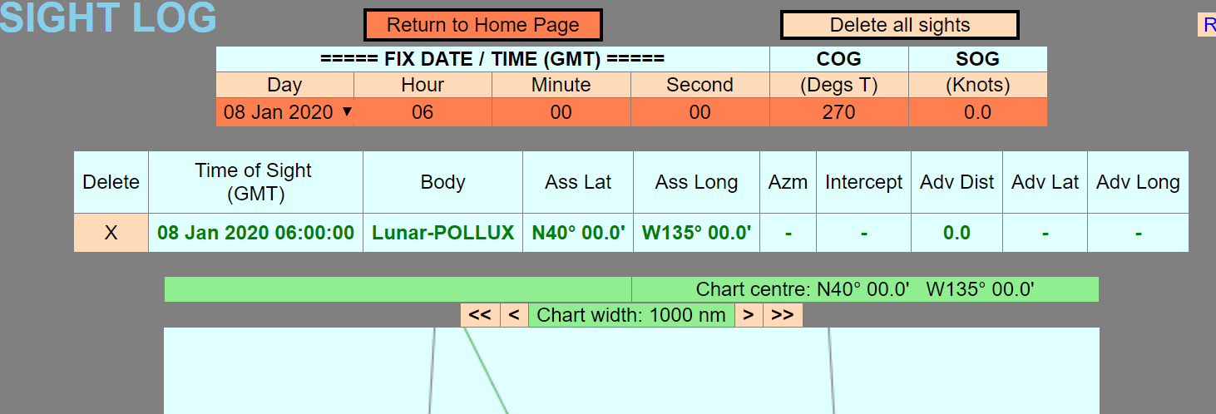
SIGHT LOG / PLOTTER PAGE : 1
This is the upper part of the Sight Log / Plotter page.
The Fix Date / Time table will be used later to advance this sight. It is automatically set to the time of the last added sight.
The next two slides show the Astron plotter and the Google Map at this stage.
s

Slide 9
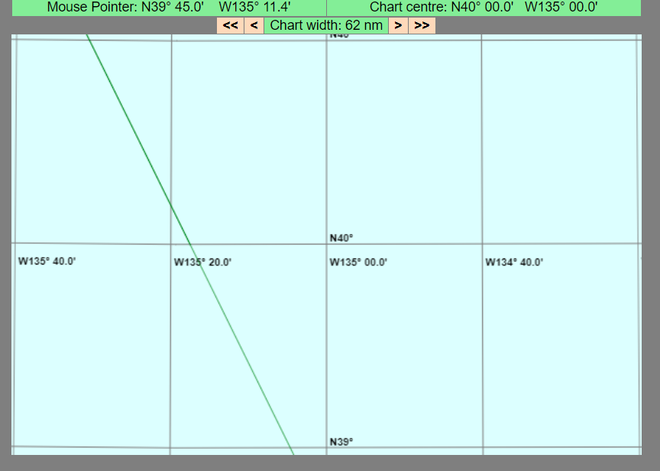
SIGHT LOG / PLOTTER PAGE : 2
This is the “Astron” chart showing the plotted LLOP. (Zoomed to shown scale.) The chart is initially centred on the Assumed Position. Note that the LLOP does not pass through the Assumed Position N40 W135. See next slide for Google Map. This indicates that the sight was inaccurate or that the Assumed Position was not exact.
(Screenshot does not capture mouse pointer image)
s

Slide 10
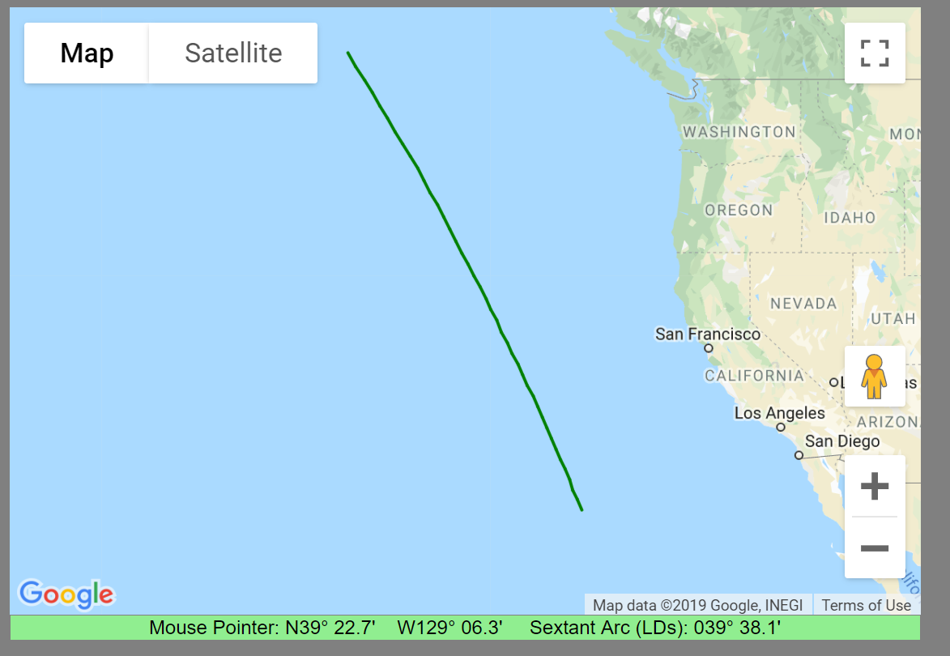
SIGHT LOG / PLOTTER PAGE : 3
This is the “Google Map” showing the plotted LLOP. (Zoomed to shown scale.)
Again, the mouse pointer image is not captured by screenshot.
The Sextant Arc is a temporary development tool that shows the arc at the mouse position at the entered time. It is interesting to move the mouse around and see how the LDs changes.
s

Slide 11
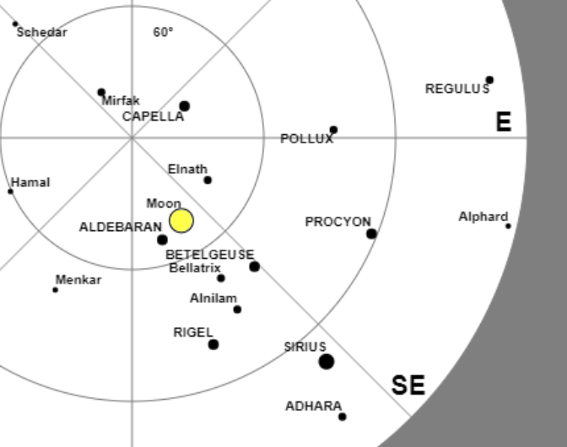
WHAT NEXT?
So, we have achieved a single Lunar Line of Position. Should a horizon become visible, we could mix this with conventional LOPs to obtain a fix. However, assuming we remain denied a horizon, we need to look at the Planner page. (Just part shown here)
From this, you can see that Procyon may also be suitable at 06:00:00 and give an cut of about 30° to the Pollux sight.
So we shall repeat the previous process assuming a second observer had taken a Procyon Lunar at the same instant.
s

Slide 12
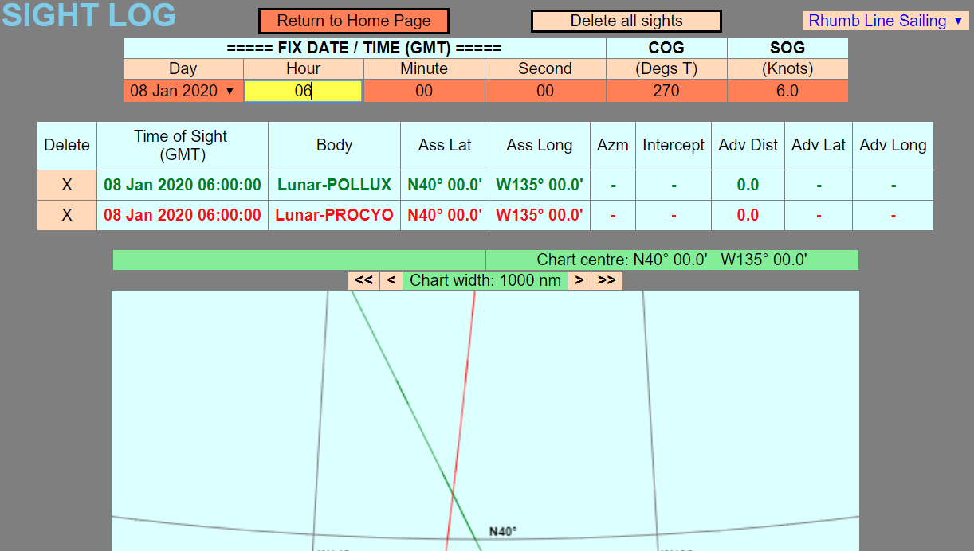
2 LLOP FIX
This is same as the previous plot, with the Procyon 06:00:00 added. As you can see, the intersection angle is poor, but as good as one can expect as all ‘suitable’ bodies are, more or less, near the plane of the ecliptic.
From now on, we shall delete the Procyon LLOP and take a different tack.
s

Slide 13
HOW ELSE?
The solution is to wait for the Earth to rotate sufficiently and then plot a ‘running’ fix. This is the LLOP equivalent of a “Sun - run - Sun” fix.
We have repeated the previous process to obtain two further LLOP’s, still using Pollux.
(By 0900, Regulus or Denebola could also have been used and, by 1200, Arcturus. See the Sight Planner page!)
At exactly 0900 GMT, Pollux LDs of 38° 25.9’ far.
At exactly 1200 GMT, Pollux LDs of 37° 07.8’, far.
In the meantime, our vessel has maintained a constant COG of 270 at 6 knots.
The next three slides show the Sight Log, Astron chart and Google Map after this has been done.
s

Slide 14
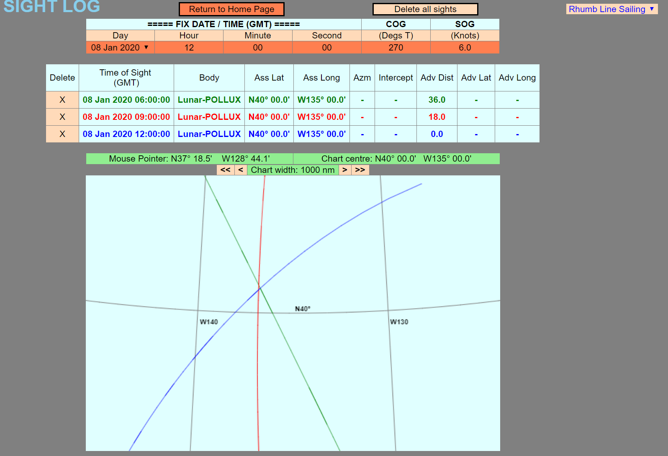
RUNNING LUNAR FIX : 1

Slide 15
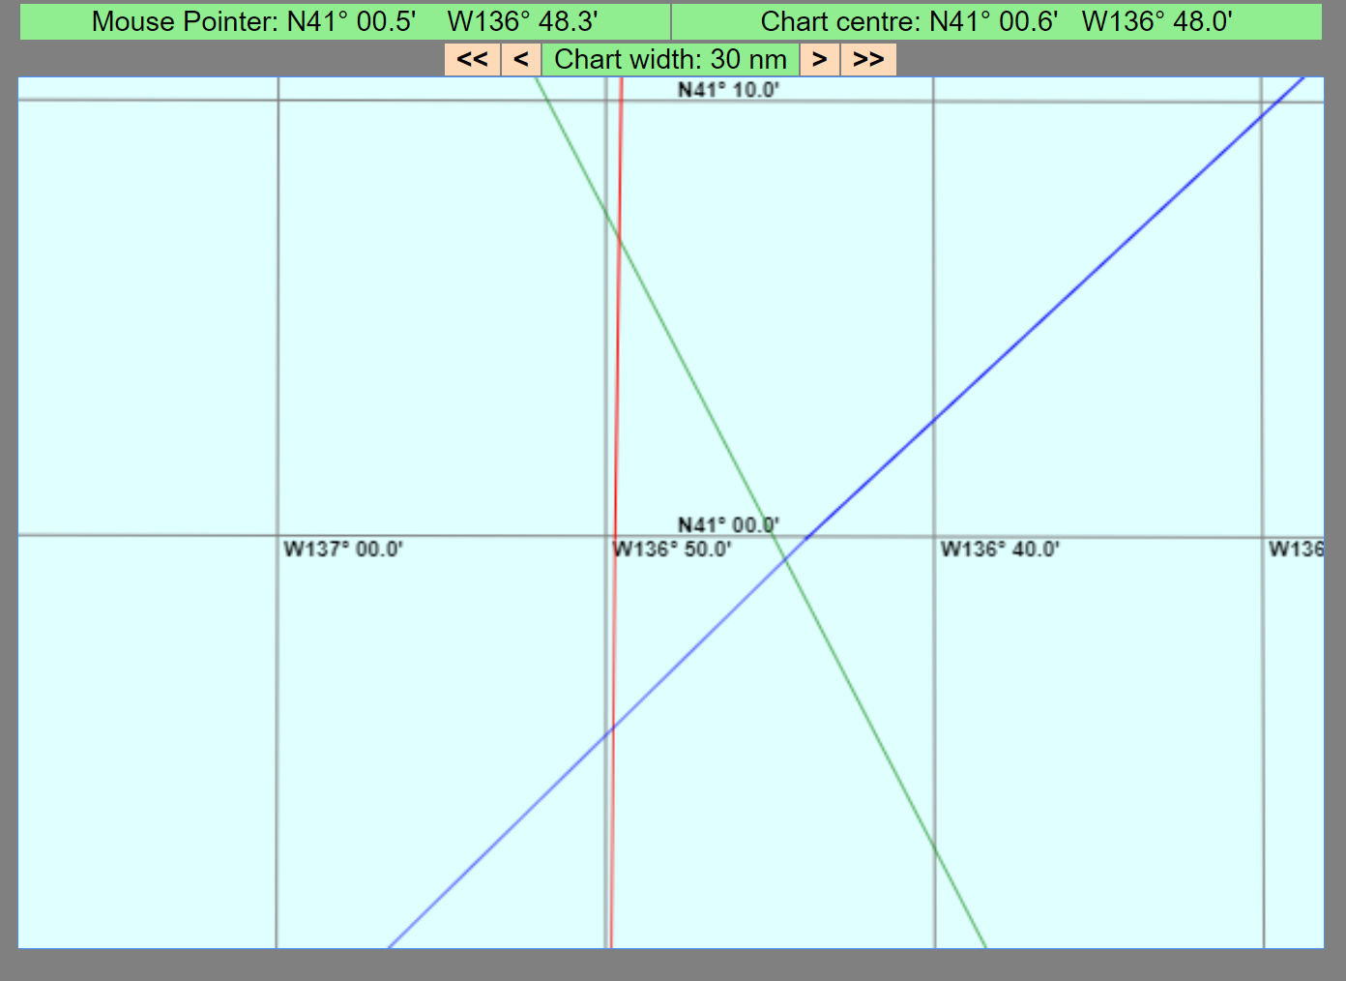
RUNNING LUNAR FIX : 2
The Astron chart, zoomed in to a chart width of 30nm, showing the ‘cocked hat’ from the three Lunar Arc sights.
The MPP at 12:00:00 is around N41° 00’, W136 ° 48’
This (pre-calculated) situation gives a sizeable cocked hat even though ‘correct’ values used. This is because input LDs values were to the nearest 0.1’ , not the exact values.

Slide 16
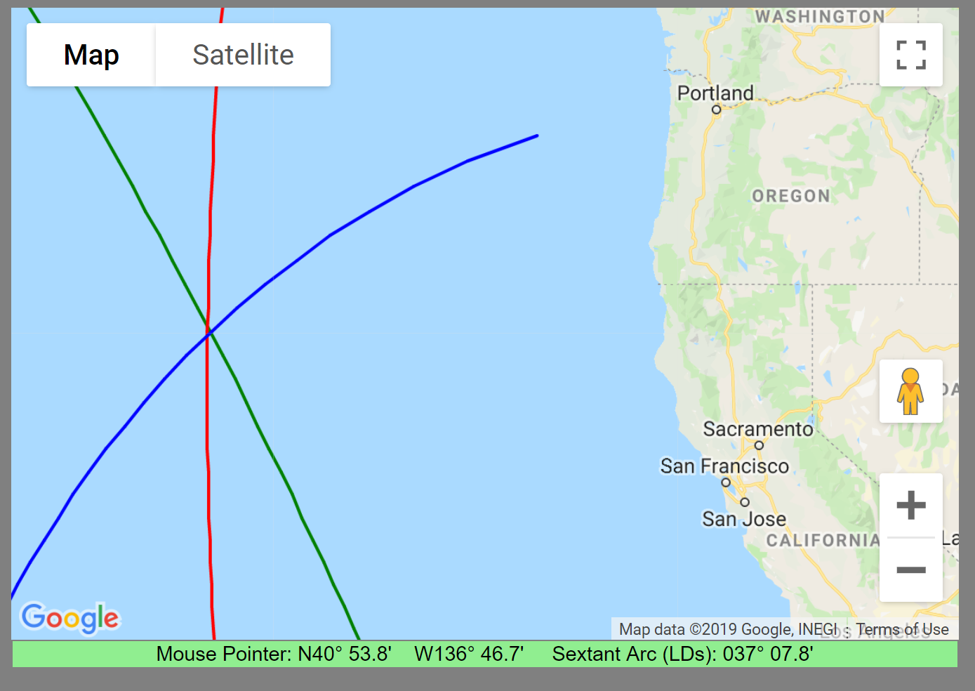
RUNNING LUNAR FIX : 3
This is the corresponding Google Map, zoomed out a little. Although not captured, the mouse was at the intersection of the three LLOPs.
6 hours of Earth rotation has given a good near 90° ‘cut’.

Slide 17
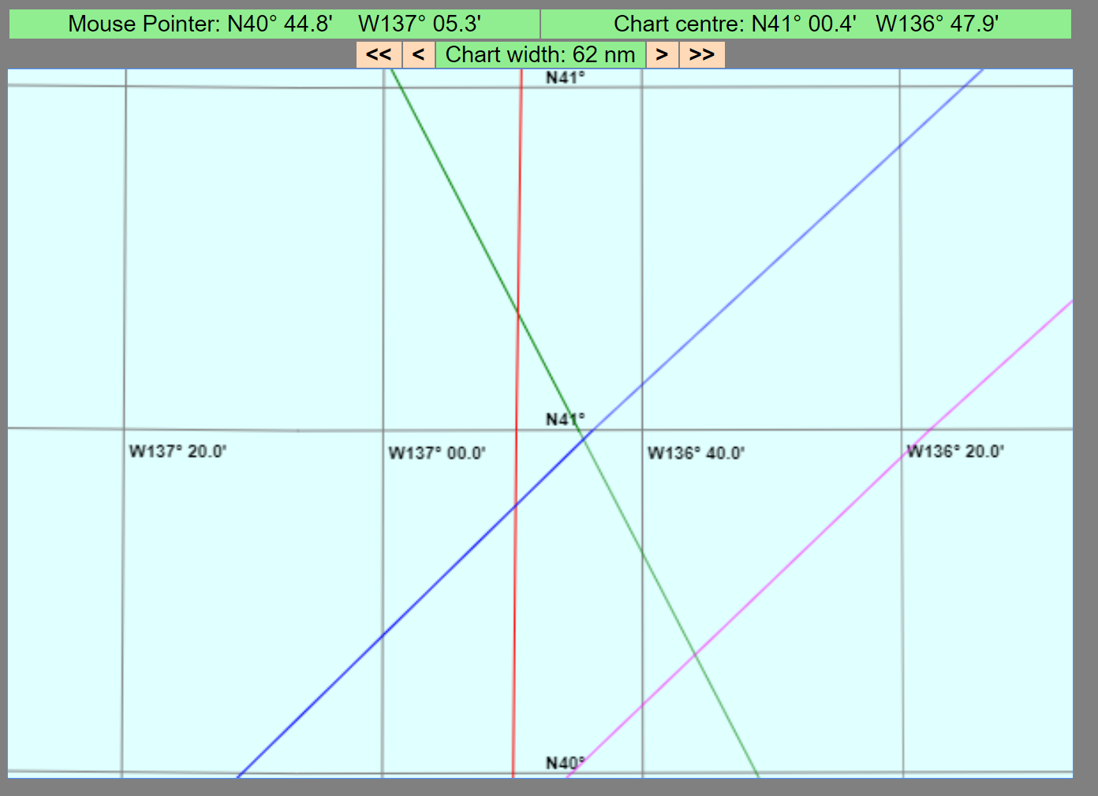
RUNNING LUNAR FIX : 4
This is the same as the last plot, but with the PURPLE sight added. This sight was the same as the 12:00:00 Pollux sight, but entered with an intentional error of 0.1’. This gives about 14nm displacement.

Slide 18
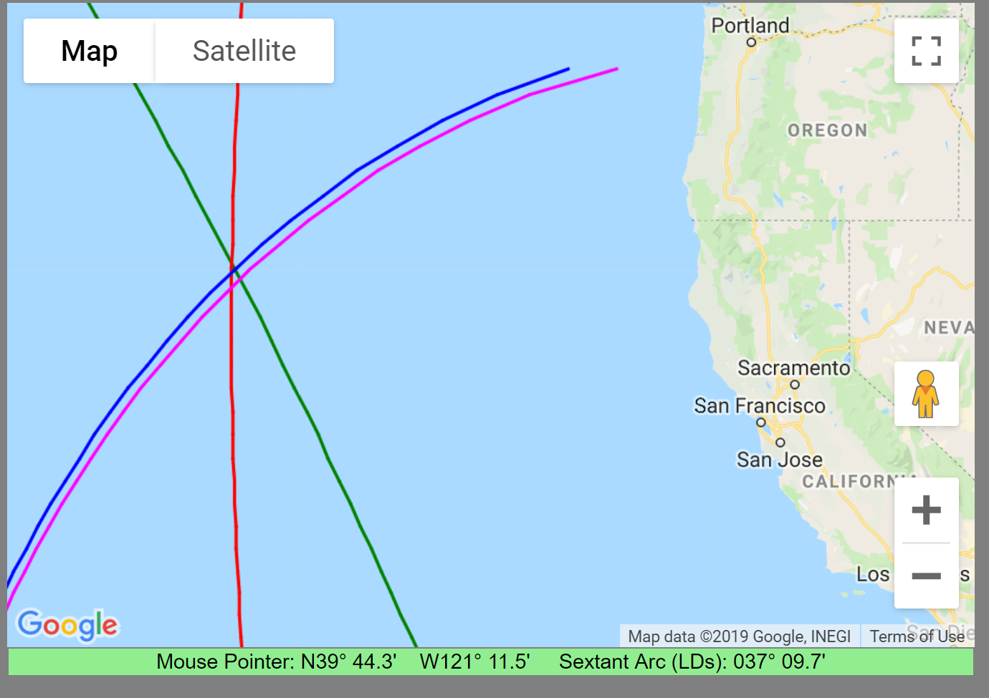
RUNNING LUNAR FIX : 5
Again, the same with the PURPLE sight added. 0.1’ intentional error, zoomed out (Approx 14nm displacement).

Slide 19
CONCLUSIONS?
1. Lunar LOPs are genuine lines (arcs) of position and can be plotted from Lunar arc measurements, with no horizon, when accurate GMT is known. As with conventional Lunar Sights, the sights must be made as carefully as possible. Plotting and averaging several sights is recommended for all Lunar observations and an observation accuracy of 0.2’ is typical. Translating this to Lunar Lines of Position, 0.2’ corresponds, in the above example, to +/- 28nm on each sight.
2. I have added this feature to Astron so that users can make up their own minds as to whether LLOPs are just a “fascinating curiosity” and “probably better than waiting for the butter to melt before turning West”, or whether they can serve as additional defensive armour against GPS denial. I’m sure some NavList contributors will have useful opinions!
3. The following are free to use and available to download from https://friendsofthevigilance.org.uk/Astron/Astron.html .
Astron.html --- the main program. (A downloadable webpage).
AstronUserNotes.docx . (Comprehensive user notes.)
Astron.pptx --- Introductory PowerPoint presentation.
Lunar Lines of Position.pptx --- this PowerPoint presentation.
4. Please note that this presentation is not updated and may differ slightly from Astron versions dated after 1st June 2019.

